Slide 1

Ggtree: A serialized data object for
visualization of a phylogenetic tree
and annotation data
Shuangbin Xu, Lin Li, Xiao Luo, Meijun Chen, Wenli Tang, Li Zhan, Zehan Dai,
Tommy T. Lam, Yi Guan, Guangchuang Yu
Department of Bioinformatics, School of Basic Medical Sciences,
Southern Medical University, Guangzhou, China
State Key Laboratory of Emerging Infectious Diseases, School of Public Health,
The University of Hong Kong, Hong Kong SAR, China
Joint Institute of Virology (Shantou University–The University of Hong Kong),
Shantou University, Shantou, China
Shuangbin Xu, Lin Li, Xiao Luo, Meijun Chen, Wenli Tang, Li Zhan, Zehan Dai, Tommy T. Lam, Yi Guan, Guangchuang Yu. 2022. “ Ggtree: A serialized data object for visualization of a phylogenetic tree and annotation data.” iMeta. e56. https://doi.org/10.1002/imt2.56
Notes:
My name is Shuangbin Xu.
I’ll introduce the paper published in iMeta. “Ggtree: A serialized data object for visualization of a phylogenetic tree and annotation data”.

Slide 2



Introduction / Results
Phylogenetic tree + Associated data
Ecology
Epidemiology
Microbiome
https://www.eden.gov.uk/your-environment/zero-carbon-eden/ecology-and-biodiversity/
https://www.azolifesciences.com/article/What-is-Epidemiology.aspx
https://www.niehs.nih.gov/health/topics/science/microbiome/index.cfm

Slide 3
Introduction
Reusing phylogenetic data can contribute to synthesize phylogenetic knowledge and comparative analyses in a number of scientific disciplines.
Problems
But ~60% of published phylogenetic data are lost to science forever [1]. This is because phylogenetic trees are often published as static images and lack of interoperable file format for data sharing [2].
Although tools for tree visualization and annotation are proliferating, the dominant objective remains to produce a publication-ready figure, which involves multiple steps in selecting the annotation data (e.g., bootstrap values) and rendering it on the tree (e.g., as text labels or branch colors). The process is one-way and a dead end to yield a static figure that the underlying information cannot be reused.
How to solve the problems
a paradigm shift from producing a static figure to a serialized data object that contains the tree, associated data and visualization directives in addition to render as a visualization graphic.

Slide 4
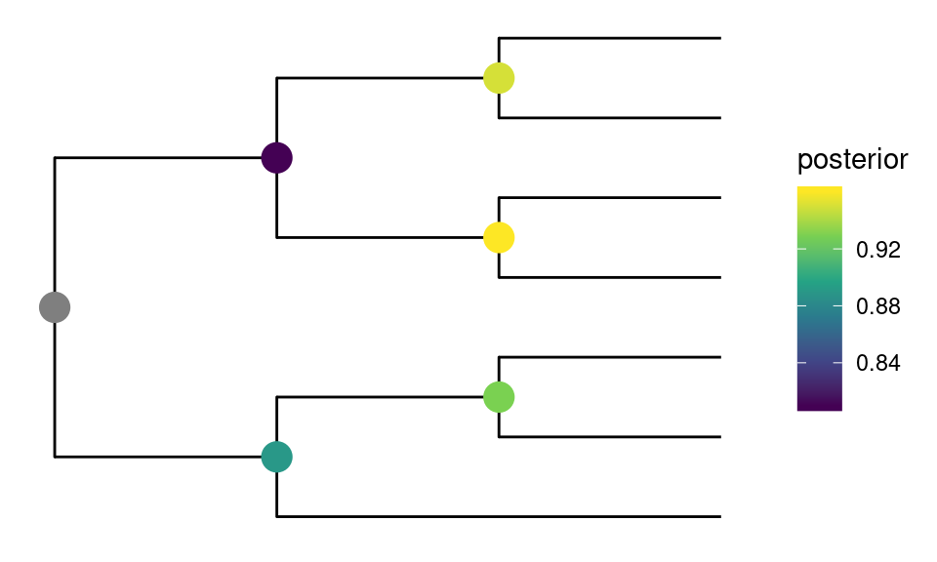
Results
Ggtree data object
# Loading the required packages
pacman::p_load(tidytree, treeio, ggplot2, ggtree)
# The url of phylogenetic tree and associated data,
# which can be replace user own files.
url <- paste0("https://raw.githubusercontent.com/TreeViz/", "metastyle/master/design/viz_targets_exercise/")
# parsing the phylogenetic tree files with
# the functions of treeio package，it will generate
# phylo or treedata object.
x <- read.tree(paste0(url, "tree_boots.nwk"))
# reading the associated data
d <- read.csv(paste0(url, "inode_data.csv"))
# constructing the ggtree object (using ggtree function) and
# adding associated data to the object (using %<+% function)
p <- ggtree(x) %<+% d +
# annotating tree with the posterior (in this example) or other data
geom_nodepoint(aes(colour = posterior), size = 5) +
# adjust the color of the data point annotated.
scale_color_viridis_c() +
# adjusting the theme of the object.
theme(legend.position = 'right')
Phylogenetic tree + Associated data
How to construct the object
the object can be rendered a static figure.
print(p)

Slide 5
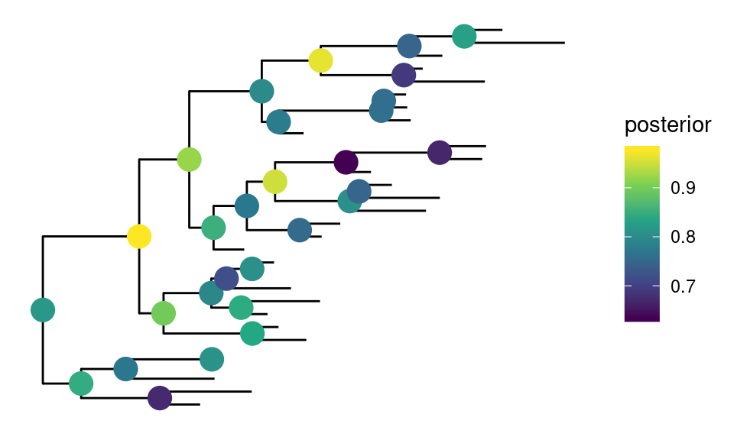
Results
## extract tree from graphic object
tree <- as.treedata(p)
## associated data is included in the tree object
get.fields(tree)
## [1] "vernacularName" "infoURL" "rank" "bootstrap"
## [5] "posterior"
## convert graphic object to Newick text
## tree can be exported with associated data into
## a single file using write.beast
write.tree(as.phylo(p))
## [1] "(((Rangifer_tarandus:1,Cervus_elaphus:1)Cervidae:1,(Bos_taurus:1,Ovis_orientalis:1)Bovidae:1)Artiodactyla:1,(Suricata_suricatta:2,(Cystophora_cristata:1,Mephitis_mephitis:1)Caniformia:1)Carnivora:1)Mammalia;"
Extracting phylogenetic tree from ggtree object
y <- treedata(phylo = rtree(30),
data = tibble(node = 31:59,
posterior = rnorm(29, 0.8, .1)))
p %<% y
The ggtree object can be used to visualize new tree object, which is similar to Microsoft Word Format Painter.

Slide 6
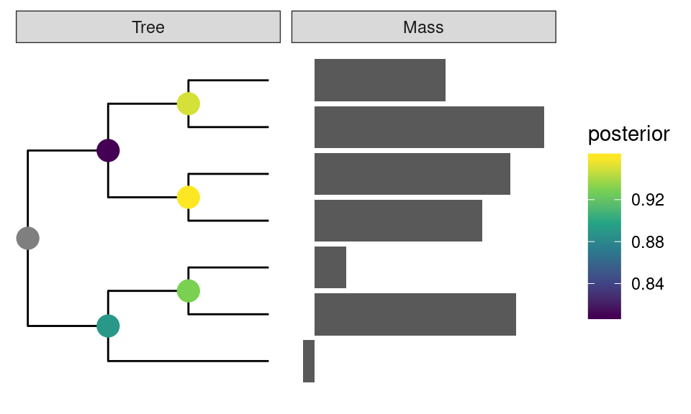
Results
info <- read.csv(paste0(url, "tip_data.csv"))
p2 <- facet_plot(p, data = info[, c(1,7,8 )],
geom = geom_col,
mapping = aes(x=log(mass_in_kg)),
orientation = 'y', panel = 'Mass')
Using facet_plot to combine the
associated data and ggtree object
facet_data(p2, 'Mass')
## label mass_in_kg trophic_habit
## 1 Bos_taurus 618.64 herbivore
## 2 Cervus_elaphus 240.87 herbivore
## 3 Cystophora_cristata 278.90 omnivore
## 4 Mephitis_mephitis 2.40 omnivore
## 5 Ovis_orientalis 39.10 herbivore
## 6 Rangifer_tarandus 109.09 herbivore
## 7 Suricata_suricatta 0.73 carnivore
Extracing the associated data added to object using facet_data.

Slide 7
Summary
The phylogenetic tree and diverse accompanying data can be stored in a ggtree graph object, which improves the reproducibility and reusability of phylogenetic data.
The phylogenetic tree and associated data can be extracted from the ggtree object, which can be reanalyzed and help various scientific disciplines synthesize their comparative studies and phylogenetic information.
The ggtree graph object can be rendered as a static image, and the visualization directives that were previously saved in the object can be reused to display a different tree object in a manner akin to Microsoft Word Format Painter.
Shuangbin Xu, Lin Li, Xiao Luo, Meijun Chen, Wenli Tang, Li Zhan, Zehan Dai, Tommy T. Lam, Yi Guan, Guangchuang Yu. 2022. “ Ggtree: A serialized data object for visualization of a phylogenetic tree and annotation data.” iMeta. e56. https://doi.org/10.1002/imt2.56

Slide 8








iMeta: Integrated meta-omics to change the understanding of the biology and environment
“iMeta” is an open-access Wiley partner journal launched by scientists of the Chinese Academy of Sciences. iMeta aims to promote metagenomics, microbiome, and bioinformatics research by publishing original research, methods, or protocols, and reviews. The goal is to publish high-quality papers (Top 10%, IF > 15) targeting a broad audience. Unique features include video submission, reproducible analysis, figure polishing, APC waiver, and promotion by social media with 500,000 followers. Three issues were released in March, June , and September 2022.
Society: http://www.imeta.science
Publisher: https://wileyonlinelibrary.com/journal/imeta
office@imeta.science
iMetaScience
Submission: https://mc.manuscriptcentral.com/imeta
iMeta
iMetaScience
Notes:
iMeta: A journal to change the world

