Slide 1

Novel RNA viruses in oysters revealed by virome
Peng Zhu, Guang‐Feng Liu, Chang Liu, Li‐Ling Yang , Min Liu ,
Ke‐Ming Xie, Shao‐Kun Shi, Mang Shi, Jing‐Zhe Jiang
South China Sea Fisheries Research Institute,
Chinese Academy of Fishery Sciences
Shanghai Ocean University
One Health Biotechnology (Suzhou) Co., Ltd.
Guangdong Pharmaceutical University
Shenzhen Fisheries Development Research Center
Sun Yat‐sen University
Zhu, P., Liu, G.-F., Liu, C., Yang, L.-L., Liu, M., Xie, K.-M., Shi, S.-K., Shi, M. and Jiang, J.-Z. (2022), Novel RNA viruses in oysters revealed by virome. iMeta, 1: e65. https://doi.org/10.1002/imt2.65
Notes:
My name is XXX.
I’ll introduce the paper submitted to iMeta. The title is “XXX”.

Slide 2
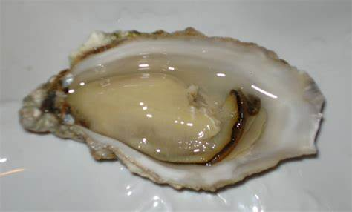
Introduction
Oysters are the mariculture variety with the highest aquaculture yield in the world.
Being filter feeders, oysters can filter up to five liters of seawater through their gills every hour.
Oysters have evidently no acquired immune system.
The identification of oyster pathogens is a top priority for oyster disease prevention and control.

Slide 3
Introduction
With the development of high-throughput sequencing technologies, methods such as viromics and meta-transcriptomics have overcome the dependence of traditional virology studies on host cell culture and greatly improved the efficiency of the discovery and identification of new viruses in invertebrates.

Slide 4
Materials and Methods
Cenote-taker2
Gephi
Mafft
iQtree
SnapGene
QinZhou
YangJiang
ZhuHai
HuiDong
LianJiang
ShenZhen
TanWei
Fastp
Megahit
Diamond
Megan6
Sequencing
Analyzing
reads
Contig
Notes:
54个基因文库

Slide 5
Results
Eighteen novel RNA viruses were found in oysters
Figure 1 The variety of novel RNA viruses found in oysters. (A) Clustering network of 147 RdRp amino acid sequences. (B) Clustering network of 99 capsid protein amino acid sequences.

Slide 6
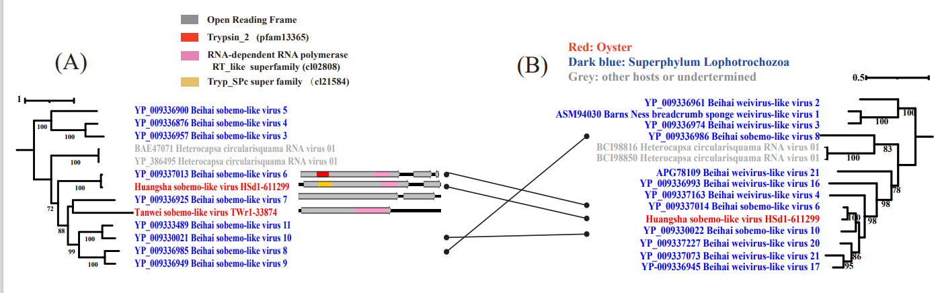
Results
The capsid protein genes of sobemo-like viruses and Weiviruses may have a common origin.
Figure 2 Phylogenic analysis shows evidence of recombination between major viral proteins. Phylogenetic trees of RdRp (A) and capsid proteins (B) of oyster-associated Sobelivirales.

Slide 7
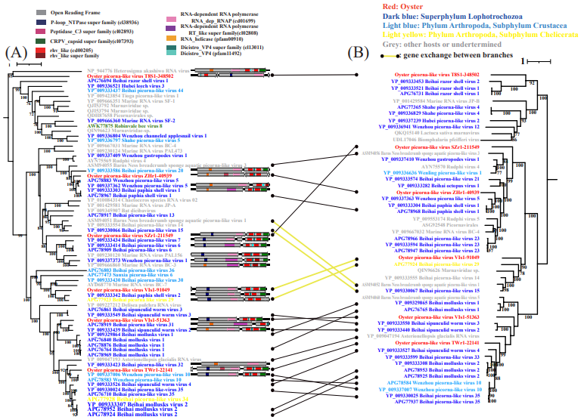
Results
The genes of picornaviruses exchange among some small branches
Figure 3 Comparison of the topological structure between the RdRp (A) and capsid (B) phylogenic trees of picornaviruses found in oysters.

Slide 8
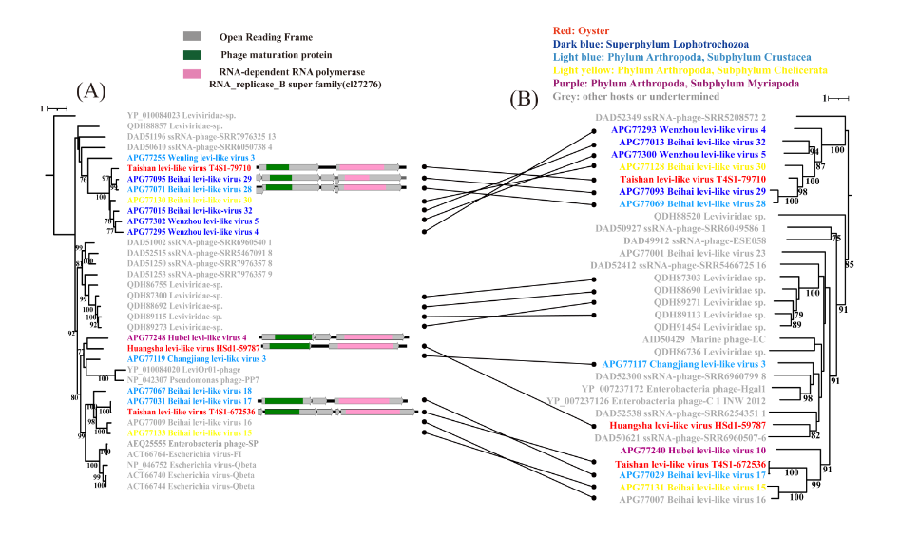
Results
Leviviridae
Figure 4 Comparison of the topological structure between the RdRp (A) and capsid (B) phylogenic trees of levi-like viruses found in oysters

Slide 9
Results
Ubiquitous and abundant oyster‐associated picobirnaviruses
Virus Name | Taxonomy | Length | RDRP | Capsid Protein | ORFs | Total FPKM
Huangsha levi-like virus HSd1-59787 | Leviviridae-like | 3730 | 1739..3538 | 50..1288 | 2 | 21.88
Taishan levi-like virus T4S1-672536 | Leviviridae-like | 3931 | 2038..3858 | 184..1443 | 5 | 3.79
Taishan levi-like virus T4S1-79710 | Leviviridae-like | 4460 | 2386..4269 | 90..1871 | 2 | 3.17
Oyster picorna-like virus T8S1-348502 | Picornavirales-like | 9336 | 3387..8762 | 896..3076 | 4 | 3.77
Oyster picorna-like virus SZr1-211549 | Picornavirales-like | 9322 | 1262..6634 | 6806..9322 | 2 | 145.32
Oyster picorna-like virus TWr1-22141 | Picornavirales-like | 8350 | 770..5383 | 5765..8350 | 3 | 42.75
Oyster picorna-like virus ZHr1-40939 | Picornavirales-like | 8898 | 804..5927 | 6113..8896 | 2 | 60.94
Oyster picorna-like virus VIs1-51363 | Picornavirales-like | 9438 | 937..5586 | 5874..8645 | 2 | 42.96
Oyster picorna-like virus VIs1-91049 | Picornavirales-like | 8918 | 818..5578 | 5709..8531 | 2 | 3.91
Oyster picobirna-like virus YJd1-298692 | Picobirnaviridae | 3685 | 2068..3591 | - | 1 | 4876.86
Oyster picobirna-like virus YJr1-11446 | Picobirnaviridae | 3240 | 1502..3016 | - | 1 | 59.16
Oyster picobirna-like virus YJr1-2332 | Picobirnaviridae | 3650 | 1941..3470 | - | 1 | 37.39
Oyster picobirna-like virus SZr1-72709 | Picobirnaviridae | 3792 | 1881..3431 | - | 2 | 212.72
Oyster-associated RNA virus ZHd1-112402 | Picobirnaviridae | 3853 | 1975..3852 | - | 2 | 51271.46
Oyster picobirna-like virus ZHr1-41827 | Picobirnaviridae | 3911 | 1885..3462 | - | 1 | 45.04
Tanwei sobemo-like virus TWr1-33874 | Sobelivirales-like | 4877 | 323..3181 | - | 1 | 4.80
Huangsha sobemo-like virus HSd1-611299 | Sobelivirales-like | 4952 | 186..3851 | 4368..4952 | 2 | 6.36
Oyster yanvirus-like virus SZr1-117762 | Yanvirus-like | 6161 | 51..4043 | - | 1 | 18.35

Slide 10
Summary
The characteristics of eighteen RNA virus genomes found in oysters are summarized in this study.
The common host transformation or host sharing of viruses in invertebrates, and the discovery that the capsid protein genes of sobemo-like viruses and Weiviruses may have undergone recombination and exchange or have a common origin, have added to the understanding of oyster-associated viruses.
Zhu, Peng, Guang-Feng Liu, Chang Liu, Li-Ling Yang, Min Liu, Ke-Ming Xie, Shao-Kun Shi, Mang Shi, Jing-Zhe Jiang. 2022. “Novel RNA viruses in oysters revealed by virome.” iMeta 1: e65. . https://doi.org/10.1002/imt2.65

Slide 11








iMeta: Integrated meta-omics to change the understanding of the biology and environment
“iMeta” is an open-access Wiley partner journal launched by scientists of the Chinese Academy of Sciences. iMeta aims to promote metagenomics, microbiome, and bioinformatics research by publishing original research, methods, or protocols, and reviews. The goal is to publish high-quality papers (Top 10%, IF > 15) targeting a broad audience. Unique features include video submission, reproducible analysis, figure polishing, APC waiver, and promotion by social media with 500,000 followers. Three issues were released in March, June , and September 2022.
Society: http://www.imeta.science
Publisher: https://wileyonlinelibrary.com/journal/imeta
office@imeta.science
iMetaScience
Submission: https://mc.manuscriptcentral.com/imeta
iMeta
iMetaScience
Notes:
iMeta: A journal to change the world

