Slide 1

A guide for comparing microbial co‐occurrence networks
Chi Liu 1 | Chaonan Li 2 | Yanqiong Jiang 1 | Raymond J. Zeng 1 |
Minjie Yao 1 | Xiangzhen Li 2
1 Engineering Research Center of Soil Remediation of Fujian Province University, College of Resources and Environment, Fujian Agriculture and
Forestry University, Fuzhou, China
2 Key Laboratory of Environmental and Applied Microbiology, CAS, Environmental Microbiology Key Laboratory of Sichuan Province, Chengdu
Institute of Biology, Chinese Academy of Sciences, Chengdu, China
Liu, Chi, Chaonan Li, Yanqiong Jiang, Raymond J. Zeng, Minjie Yao, and Xiangzhen Li. 2022. “A guide for comparing microbial co‐occurrence networks.” iMeta. e71. https://doi.org/10.1002/imt2.71
Notes:
My name is XXX.
I’ll introduce the paper submitted to iMeta. The title is “XXX”.

Slide 2
Introduction
Microbial co-occurrence network has been a commonly-used approach to reveal the complex inner patterns of microbial communities
Questions:
statistical inference to get direct association?
association represents biological interaction?
association represents roles of
ecological niches?
network benchmarking？
how to compare networks？
Ecological question
Biological question
environmental selection
phylogenetic clustering
functional convergence
niche breadth
......
cross-feeding
mutualism
competition
antagonism
......
1. compare networks constructed from different groups of samples
2. compare networks constructed from different network approaches
How to do？
What to do？

Slide 3
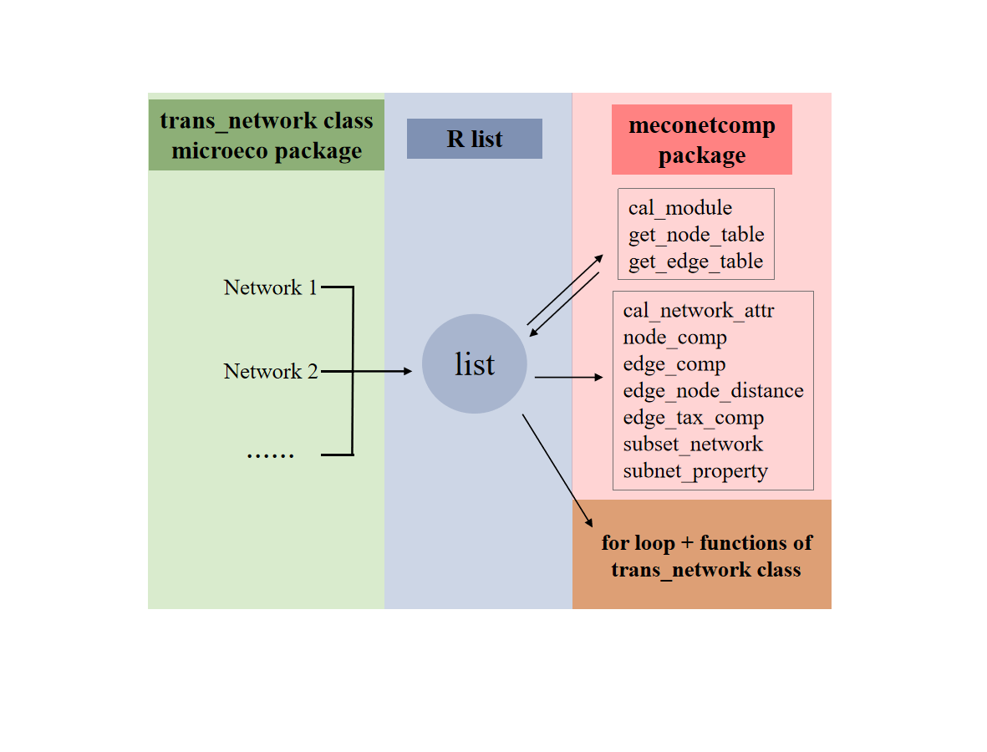

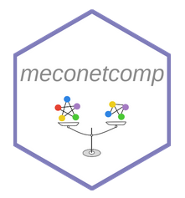
How to do?
Whole strategy:
Network
construction
Merge
Compare
https://github.com/ChiLiubio/meconetcomp
Has been released in CRAN
trans_network class

Slide 4
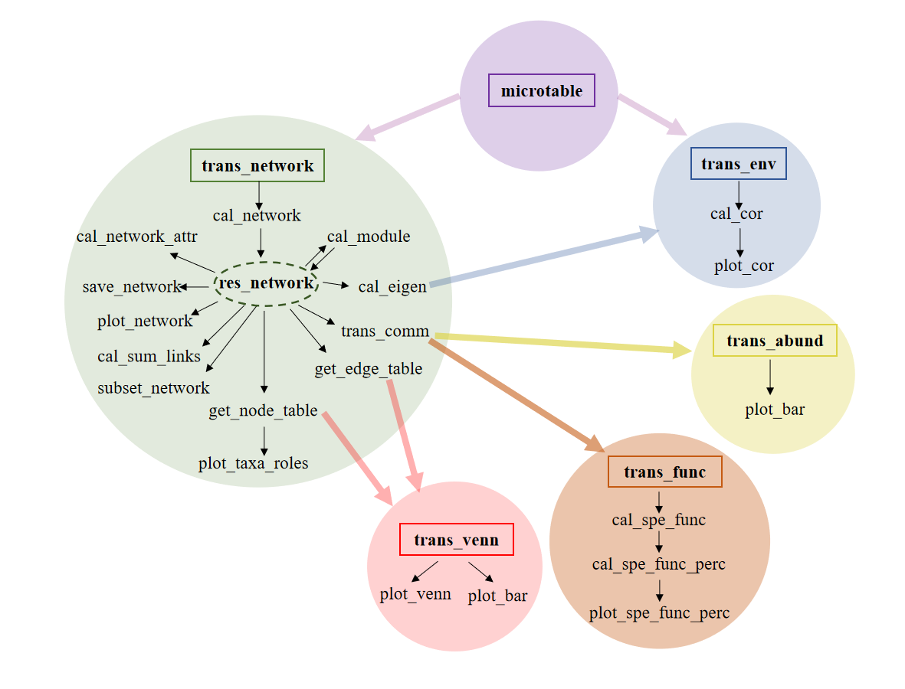
How to do?
Approaches used:
Combined use of multiple classes of microeco package can help compare networks

Slide 5
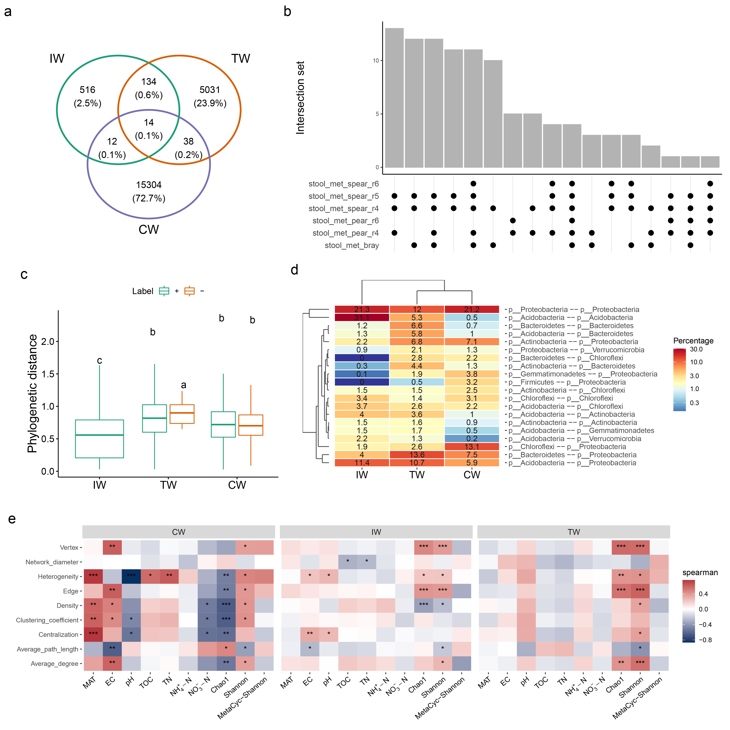
What to do?
Example:
Network topological attributes
Nodes comparison
Edges comparison
Phylogenetic distances between nodes
Taxonomic information of nodes in edges
Extract subnetwork
Topological properties of subnetworks

Slide 6
Summary
R meconetcomp package is developed to facilitate network comparison.
Combined use of multiple classes of microeco package can help compare networks.
The protocol has rich contents, high flexibility and expansibility for network comparison.
Liu, Chi, Chaonan Li, Yanqiong Jiang, Raymond J. Zeng, Minjie Yao, and Xiangzhen Li. 2022. “A guide for comparing microbial co‐occurrence networks.” iMeta. e71. https://doi.org/10.1002/imt2.71

Slide 7








iMeta: Integrated meta-omics to change the understanding of the biology and environment
“iMeta” is an open-access Wiley partner journal launched by scientists of the Chinese Academy of Sciences. iMeta aims to promote metagenomics, microbiome, and bioinformatics research by publishing original research, methods, or protocols, and reviews. The goal is to publish high-quality papers (Top 10%, IF > 15) targeting a broad audience. Unique features include video submission, reproducible analysis, figure polishing, APC waiver, and promotion by social media with 500,000 followers. Three issues were released in March, June , and September 2022.
Society: http://www.imeta.science
Publisher: https://wileyonlinelibrary.com/journal/imeta
office@imeta.science
iMetaScience
Submission: https://mc.manuscriptcentral.com/imeta
iMeta
iMetaScience
Notes:
iMeta: A journal to change the world

